Slide 1

Prediction of Credit Default Risk
Capstone Project by Abhinav Pandey

Slide 2

Contents
Problem
Data Solution
About the Dataset
Evaluation Metric

Slide 3

Problem Statement
The most important task for any lender is to predict the probability of default for a borrower. An accurate prediction can help in balancing risk and return for the lender; charging higher rates for higher risks, or even denying the loan when required.
This helps genuine borrowers also as they can get loans as per their risk-profiles; also lower default-rates help in keeping the rates lower.

Slide 4
Contents
Problem
Data Solution
About the Dataset
Evaluation Metric

Slide 5

Data Solution
Using historical data, we can train machine learning algorithms to understand patterns between credit defaulters and (with a certain degree of certainty) identify them.

Slide 6
Contents
Problem
Data Solution
About the Dataset
Evaluation Metric

Slide 7
About the dataset
Source – Home Credit Default (Kaggle)

Slide 8
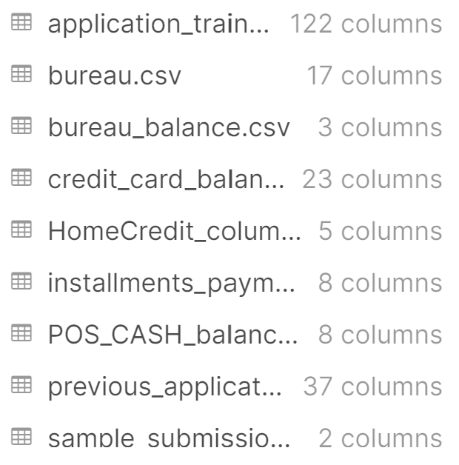
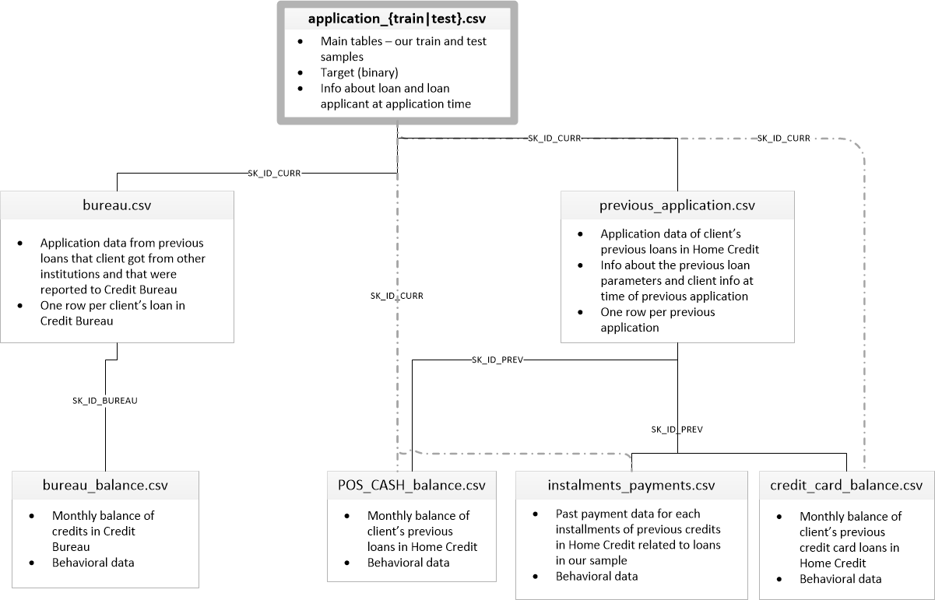
Schema

Slide 9
Contents
Problem
Data Solution
About the Dataset
Evaluation Metric

Slide 10
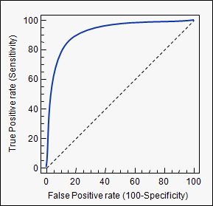
Evaluation Metric
ROC Area Under Curve
Reliable for classification
Great for evaluating unbalanced classification performance

